Slide 1

AI Governance for a Scalable Impact
Capgemini response to LLA’s AI Use Case Project RFP
21 April 2026 • Capgemini

Slide 2
Statement of Purpose
Capgemini is pleased to respond to LLA’s RFP for the AI Use Case Project, with a focused objective:- to enable a governed, product‑led, and value‑driven AI model across LLA within a six‑month horizon.
Our engagement directly aligns to LLA’s priorities across AI governance, use‑case productization, experimentation, and measurable value realization, balancing enterprise consistency with flexibility for the four local markets.
Through this program, we will:-
Design and operationalize a pragmatic AI governance model, defining clear roles, decision forums, and interaction mechanisms between corporate and local OpCos.
Translate priority AI use cases into deployable AI products, with explicit definitions of models, agents, success metrics, and experimentation logic.
Establish a repeatable AI delivery framework, including standard experiment designs, value‑capture indicators, and a consistent use‑case lifecycle.
Support deployment and experimentation alongside technical partners, with an intention to validate outcomes and measure impact on core business KPIs.
Consolidate insights and define an AI evolution roadmap, ensuring LLA teams are equipped to sustain and scale AI adoption beyond the program.
Capgemini takes end‑to‑end ownership across groundwork, design, launch, measurement, and roadmap definition, with a strong emphasis on accountability, transparency, and execution discipline.
Our commitment is to act as a long‑term transformation partner, ensuring AI at LLA is responsibly governed, scalable, and consistently delivers tangible business value.

Slide 3

Content
Capgemini Overview
Your Ask and Need for AI Governance
AI Governance Control Tower
AI Use Case Enablement
Implementation Blueprint
Knowledge Transfer
Commercials
Indicative Roles
Our Credentials
Assumptions

Slide 4
Content
Capgemini Overview
Your Ask and Need for AI Governance
AI Governance Control Tower
AI Use Case Enablement
Implementation Blueprint
Knowledge Transfer
Commercials
Indicative Roles
Our Credentials
Assumptions

Slide 5


Our deep knowledge of the Liberty’s ecosystem strongly positions us to design your AI governance function, facilitating use case experimentation and scaling
LONGSTANDING PARTNERSHIP
Deep understanding of the Liberty’s operating context
Proven ability to work within Liberty’s platform and vendor landscape
Embedded Engagement Across LLA OpCos and Local Markets
Experience governing and delivering through change while scaling capabilities
What this partnership enables for LLA’s AI programme
We understand how Liberty operates across central teams and local markets, enabling us to design AI governance models that fit the real LLA ↔ OpCo dynamic, not theoretical constructs.
This allows faster mobilization and realistic governance design from Day 1.
We have worked directly within Liberty’s complex platform and vendor environment, including BSS, integrations, and multi‑vendor operating models.
We bring practical insight into data, system, and vendor constraints that impact AI agent deployment and experimentation.
This ensures AI use cases are designed for deployability, not just analytical correctness.
We have operated alongside OpCo leadership and delivery teams across LLA markets, balancing enterprise standards with local execution realities.
We bring experience tailoring AI governance, experimentation, and rollout to different market maturity levels without fragmenting the operating model.
This directly supports LLA’s requirement for coordinated but federated execution
We have demonstrated track record of supporting programs where new operating models were introduced while delivery continued in parallel.
We bring structured approaches to introducing AI governance, experimentation discipline, and lifecycle controls without disrupting active initiatives.
This aligns with LLA’s need to let governance catch up with AI delivery, rather than slow it down.
We can design and implement AI governance that works across LLA and local markets.
We can productize prioritized AI use cases (agents, metrics, experiments, deployment logic) faster and with lower execution risk.
We can support rollout and measurement alongside technical partners, validate impact, and transfer capability to LLA teams within the 6‑month horizon.
Faster execution, lower delivery risk, and a measurable AI impact across LLA markets.

Slide 6
Content
Capgemini Overview
Your Ask and Need for AI Governance
AI Governance Control Tower
AI Use Case Enablement
Implementation Blueprint
Knowledge Transfer
Commercials
Indicative Roles
Our Credentials
Assumptions

Slide 7


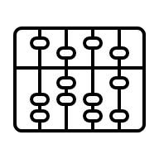


LLA is looking for a partner to develop AI governance capabilities and deploy AI use cases
YOUR ASK
Scope of the engagement
Design and implement the AI governance model: roles, processes, and interaction mechanisms between corporate headquarters and the 4 local markets.
Develop product definitions for the AI use cases selected across the different LLA markets: models, agents, metrics, experiments, and deployment logic.
Build the program’s methodological framework — reusable assets for experiment design, value capture indicators, and AI use case lifecycle — ensuring consistency across use cases.
Support use case deployment in coordination with the relevant technical partners (Developers, Data Engineers, Data Scientists, etc.), validating experiments and measuring impact on business KPIs.
Consolidate lessons learned and define the AI evolution roadmap for corporate headquarters and local operations.
High-level activities
Groundwork
Functional Design for AI Products
Launch and Measurement
Evolution Roadmap
1
Design of the AI governance model: roles, committees, processes, and corporate operations mechanisms.
4
End-to-end definition of prioritized use cases for LLA markets: models, agents, required process changes, and success criteria.
7
Coordination of the gradual rollout of models and agents across local operations.
10
Consolidation of lessons learned and reusable assets from the program.
2
Construction of the methodological framework: experiment templates, value capture indicators, and cross-cutting criteria.
5
Design of business experiments: treatment and control groups, statistical significance, and scale-up plan.
8
Experiment monitoring and results validation: statistical significance, lift, and value capture.
11
Definition of the roadmap for each use case based on results and feedback from each market.
3
Onboarding of the 6 use cases and kickoff of the initial product definitions.
6
Launch of the governance model and support to the technical partner throughout
development.
9
Derivation of post-launch insights and proposal of iterative improvements per use case.
12
Knowledge transfer of methodological capabilities to LLA internal teams and OpCos.

Slide 8

A scalable AI governance and use case op model for LLA that evolves with AI maturity, delivers measurable business value, and is controlled by LLA
OUR VALUE PROPOSITION
01
02
03
04
05
Governance model design & Implementation
Productize AI use cases from concept to scalable business products
Structured framework to scale experiments consistently
Supported launch, measurement, and validation alongside partners
Turning pilots into repeatable capability and evolution roadmaps
Hands‑on experience designing AI governance operating models across corporate LLA and markets.
Implemented clear roles, forums, decision rights, and interaction mechanisms that provide enterprise visibility while respecting OpCo autonomy.
Experience in deploying similar solutions in environments where governance needed to catch up with fast‑moving AI delivery, without slowing teams down.
Define AI use cases as end‑to‑end business products, not isolated models covering agents, decision logic, process changes, metrics, and deployment rules.
Bring experience translating prioritized use cases into clear product definitions with different maturity levels.
Support clients in moving from pilots to production by making “what good looks like” explicit for each use case.
Bring a reusable AI use case methodology covering experiment design, value capture indicators, and lifecycle management.
Built and applied experiment templates, KPI frameworks, and stage‑based lifecycle assets that ensure comparability across use cases and markets.
Enabled teams to learn fast, iterate safely, and scale with confidence.
Worked alongside technical partners (Data Engineers, Data Scientists, Developers) to support use case deployment and rollout.
Bring structured approaches to monitoring experiments, validating statistical significance, and confirming business KPI impact.
Enabled business leaders to make evidence‑based scale / hold / iterate decisions, rather than relying on anecdotal outcomes.
Consolidated lessons learned and reusable assets into playbooks that allow organizations to scale AI independently.
Delivered knowledge transfer and capability handover so governance, experimentation, and measurement continue beyond the engagement.

Slide 9
Across industries, we are witnessing an urgent need to have dedicated AI governance…
TREND
Industries are struggling with AI governance…
…because of structural irregularities and adoption inconsistencies
organizations report having a dedicated AI governance process but only 12% describe their efforts as mature¹
of companies make their AI policies accessible to employees or require acknowledgment, meaning most policies exist on paper but not in practice³
75%
41%
of organizations reach the highest level of governance readiness¹
organizations say that the governance of AI is inconsistent across various business functions in their organization²
16%
47%
of organizations with governance policy for their AI systems says employees seldom follow it²
say the governance process is too slow; 24% say it’s overwhelming. Streamlining intake and ownership could unlock serious momentum⁴
47%
44%
¹Cisco Systems; research report; Cisco AI Readiness Index 2025. ²Capgemini Research Institute; research report; Harnessing the Value of AI, 2025. ³Thomson Reuters Foundation; blog; AI governance gaps are creating ESG risks, world’s largest dataset finds, 2025. ⁴Corinium Intelligence; research report; AI’s time to Market Quagmire, 2025

Slide 10






…and for the telecom operators, it is even more critical
TREND
Telecom AI functions on a large scale
Telecom systems affect millions of users, important revenue, and essential services.
Minor model mistakes or biases can lead to widespread dissatisfaction or regulatory issues.
Telecom AI must operate alongside critical functions
Telecom settings require controlled testing, reliable services, and clear escalation procedures.
AI governance enables innovation while maintaining operational stability.
Vendor-integrated AI increases complexity
Operators rely heavily on vendors for BSS, call-center systems, network tools, and AI.
Deep integration often reduces transparency and accountability, making proper governance essential to ensure vendor AI meets internal standards.
AI impacts customer interactions in telecom
Key areas include chatbots, collections prioritization, and sales offers.
These affect pricing, eligibility, service quality, and outcomes, requiring new governance approaches.
AI Governance Criticality for Telco Operators
Regulators increasingly expect structured AI oversight
Even where explicit AI regulation is still evolving, telecom regulators increasingly expect documented decision logic, fair customer treatment, explainability and escalation mechanisms.
Governance prepares operators to respond proactively, not defensively.
Multi-market telcos encounter varying maturity and regulations
Telecom groups work in multiple countries with different AI maturity, regulations, consumer needs, data quality, and systems.
Governance should combine central guidelines with local implementation.

Slide 11

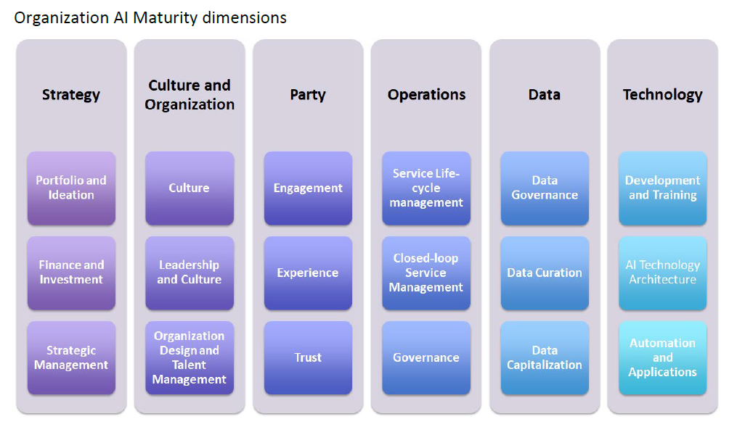
We recommend a learning-led maturity evolution anchored in real value delivery, guided by design principles, and benchmarked by TM Forum
AI GOVERNANCE FOR LLA
Evolution of AI governance model…
Stage 1: Status Quo
Stage 2: Pilot
Fragmented & Use‑Case Led
AI initiatives driven locally by use case urgency
Governance exists but is lightweight and inconsistent across OpCos
Primary focus on delivery speed and experimentation
Guided & Risk‑Based
Clear North‑Star governance model established
Minimum guardrails defined at Group level
Risk‑tiered controls applied only where value or risk demands
Governance tested and refined through real use cases
Scaled & Embedded
Consistent visibility across all markets and functions
Governance embedded into delivery and operations
AI scaled with confidence, trust, and repeatability, without slowing innovation
Stage 3: Scale & Beyond
Determined by design principles
(non-exhaustive)
Clear federated operating model
Governance forums with well-defined decision rights
Risk‑tiered controls
Use case productization
Reusable assets that make scaling consistent
Deployment and measurement operating model
Vendor and procurement governance
Benchmarked by TM Forum AI Maturity Model

Slide 12
Content
Capgemini Overview
Your Ask and Need for AI Governance
AI Governance Control Tower
AI Use Case Enablement
Implementation Blueprint
Knowledge Transfer
Commercials
Indicative Roles
Our Credentials
Assumptions

Slide 13











Evolution of AI governance is predicated on three pillars: Robustness; Ethics; and Lawfulness
GOVERNANCE PILLARS
Governance requirement
Evolution and definition of governance principles
Enforcement through dedicated governance bodies and processes
Robustness
Target Operating Model
Define how AI governance integrates into org structures with Governance bodies, roles & responsibilities, lifecycle integration, operating cadence.
AI systems reliability & resilience
Risk assessment and treatment processes
Monitoring & Evaluation
Regulations
(GDPR, EU AI Act, GCC data protection , sectoral laws etc.)
Risk & Compliance Framework
Mechanisms to ensures lawful, robust, and ethical AI use through structured risk management and regulatory alignment.
Ethics
Responsible AI use
Fairness, accountability, and explainability
Privacy and Data Governance
Standards (ISO, NIST, OECD)
Policies for AI Compliance
Outlining principles into actionable organization rules & guidelines.
Lawfulness
Organization Context, AI Strategy
AI legal & regulatory requirements
Copyright, liability laws adherence
Regulatory guidelines contractual obligations
AI Adoption and Enablement
Builds organizational culture, competence, and trust in AI governance.
Translate governance principles into AI Policies to standardize practices, ensure regulatory compliance, and enable auditability.
Establish an AI TOM and Risk & Compliance Framework to embed lawfulness, robustness, and ethics into organizational processes, roles, and decision rights
Drive training, awareness, and literacy programs to build competence, foster a culture of responsible AI, and ensure sustainable, ethical adoption across business units.

Slide 14
These pillars demand distinct accountability from the members of the AI governance
ROLE ACCOUNTABILITY
Role
Evolution and definition of governance principles
Enforcement through dedicated governance bodies and processes
AI Governance Manager
Owns regulatory interpretation; sets guardrails & risk thresholds
Defines acceptability thresholds, ethical principles & lawfulness accountability across all three pillars
Chairs governance bodies; ratifies TOM, Risk Framework & adoption strategy
Senior AI Product Owner
Ensures portfolio alignment with regulatory posture
Balances robustness investment, ethical trade-offs & lawful product positioning
Accepts/stops products at governance gates; steers adoption programmes
AI Product Owner
Translates requirements into product-level constraints
Embeds robustness testing, ethical checks & lawful data usage into product backlog
Implements governance controls operationally within owned use-cases
AI Development Analyst
Maps regulatory items to measurable KPIs & evidence criteria
Conducts bias, fairness, reliability & audit-evidence analysis
Tracks adherence metrics; generates compliance & board-level reports
Solution Architect¹
Assesses technical feasibility of regulatory requirements
Designs explainability, bias-mitigation & resilience architectures
Engineers’ governance controls: gates, lineage, monitoring pipelines
Project Manager¹
Plans governance workstreams, tracks regulatory deadlines
Coordinates cross-pillar delivery; manages risk register
Tracks governance milestones; reports status to governance bodies
¹Addtional roles recommended as part of the AI governance team to support business functions

Slide 15
We have distilled our expertise into our comprehensive AI framework to guide LLA’s AI governance journey
AI STRATEGY FRAMEWORK
Layer
Components of the framework
AI Strategy
Definition vision, mission & focus / anchoring & scaling
Governance & Compliance
Target Operating Model
Blueprint for processes, roles and responsibilities
Regulatory & Compliance
Consideration of regulatory requirements (e.g. EU AI Act)
Workforce Empowerment
Reskilling and upskilling with the right communication strategy
Application (use cases)
Use-Case-Factory Setup
Identification, definition, implementation of (Gen)AI use-cases to increase productivity
Internal company perspective (No pre-training with company data)
External perspective (customer interaction; pre-training with company data is required)
Internal Use of ChatGPT, Microsoft Copilot, etc.
Software engineering / empowerment of the developer community
Internal knowledge databases/chat with company information
Identified Solutions /UCs for Business
Data
Data Basis
Data strategy / data quality / data interfaces & access management / data governance
Tool
External (Gen)AI Providers & Tools
Comparison, selection and implementation
Infrastructure
(Cloud) Infrastructure
Co-implementation with our strategic partners / multi-cloud & exit strategy

Slide 16
Each layer has a distinct ownership pattern, preventing redundancy and gaps
ROLES OWNERSHIP
Layer
Roles in LLA AI Governance
AI Governance Manager
Senior AI Product Owner
AI Product Owner
AI Development Analyst
Solution Architect¹
Project Manager¹
Governance & Compliance
Sets AI governance vision, TOM design & decision rights
Aligns portfolio to strategy; owns governance touchpoints
Converts governance requirements into product roadmaps
Measures governance effectiveness & compliance posture
Designs governance architecture & control systems
Plans & tracks governance workstream delivery
Application (use cases)
Defines risk tiering & approval thresholds per use-case
Selects & prioritizes high-value, low-risk AI opportunities
Owns each use-case end-to-end through delivery
Performs feasibility, value & regulatory impact assessment
Designs solution pattern (GenAI vs ML, build vs buy)
Manages use-case delivery plan, dependencies & risks
Data
Defines data governance, privacy & retention policy
Aligns data investments to product value
Ensures compliant data usage in training / inference
Data quality, lineage, bias, representativeness analysis
Designs secure data pipelines & access controls
Tracks data readiness milestones & blockers
Tool
Approves vendor/tool usage from governance & risk lens
Decides build vs buy vs partner at portfolio level
Selects tools aligned to product needs
Evaluates performance, cost & risk trade-offs
Owns architecture, integration design & exit strategy
Manages vendor onboarding schedule & contracts
Infrastructure
Ensures infra enables audit trail & traceability
Provides strategic input on cloud & exit planning
Aligns infra choices to product delivery needs
Assesses technical feasibility, performance & cost
Owns cloud architecture, security & resilience design
Coordinates infra delivery with cloud partners
¹Addtional roles recommended as part of the AI governance team to support business functions

Slide 17
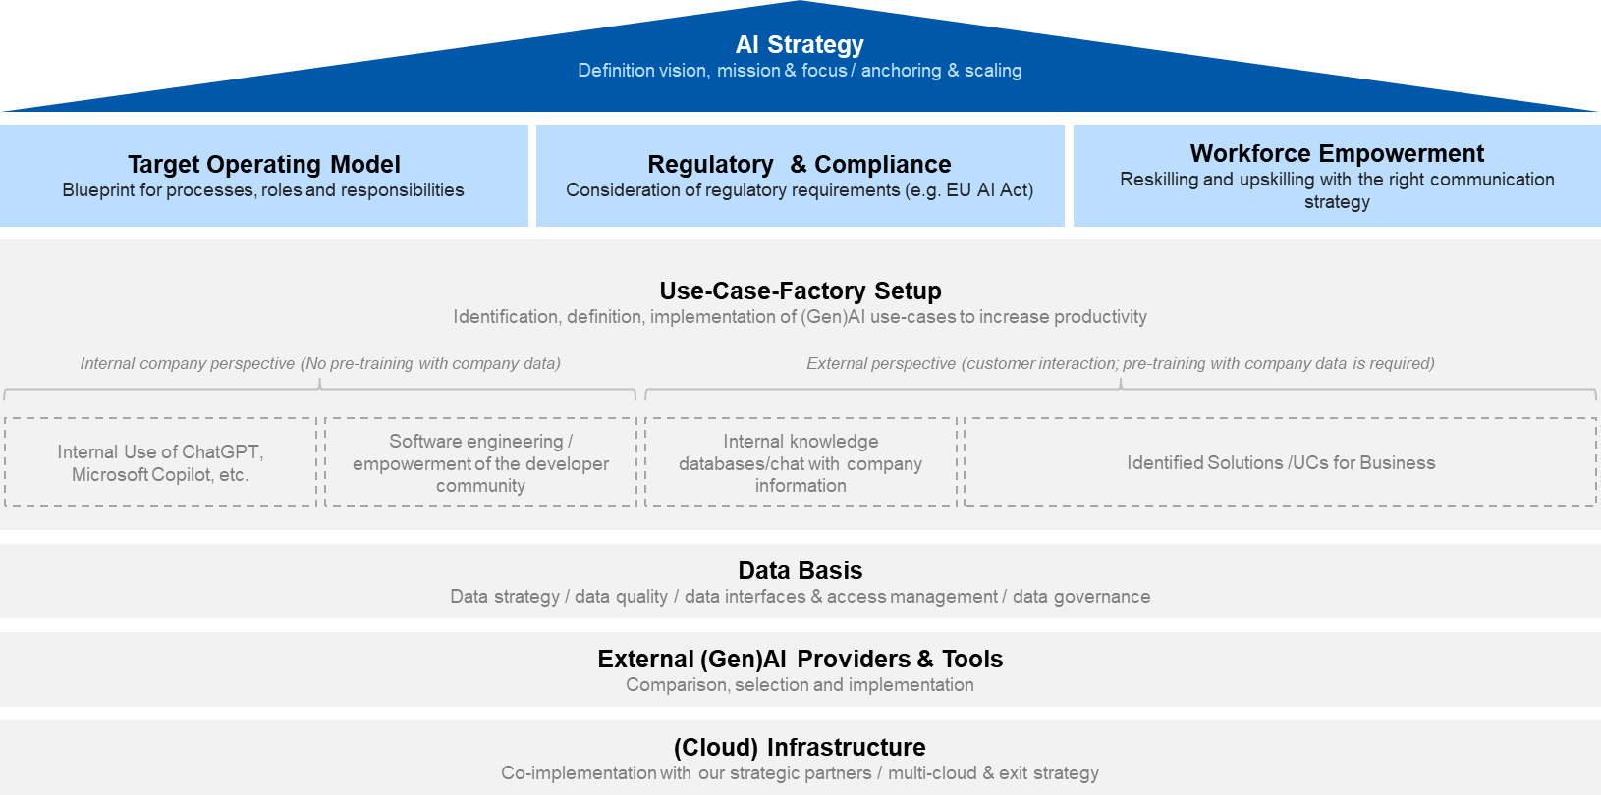
We recommend establishing an AI Control Tower as a centralized governance body for LLA…
AI CONTROL TOWER
01
02
03
04
05
Governance &
Decision Layer
AI Use Case Orchestration Layer
Value Realization layer
Knowledge Management Layer
Enabler and Cross Integration layer
Tenets
Define AI governance standards, policies, and guardrails consistent across Teams, Departments & Markets.
Establish Communication Plan, Policy adherence, use case deployment adherence w.r.t defined guardrails.
  Cross Market Operating & Communication Model & Plan rollout
Manage the AI use case portfolio across markets and assist/highlights challenges, dependencies, delays and deviations.
Responsible for consistency in methodologies, metrics, and deployment approaches
  Single cross‑market dashboard
  Structured market feedback loop into Control Tower
Focus on exploiting measurable value for the AI Use Case deployment program.
Ongoing AI Use case embedded Value Tracking & Dashboarding.
  Centralized Performance Dashboard
  Risk & compliance Register
Define Knowledge Management framework and share across team, departments and markets.
Maintain reusable assets, training materials and playbooks.
Track trainings, adoptions and failures of change
  Centralized documentation
  Learnings Repository
Evolve the foundations for scalable, factory‑style execution (data, tooling, processes, etc.).
Continuously review data, tooling, processes, and automation readiness.
Prioritize high‑value E2E impact of AI use case deployment across markets.
Design & Artefacts
AI Governance Manager & Sponsor
Cross Market SPOCs & Functional Teams
AI Governance Manager.
AI Product Owners, Market SPOCs & Functional teams
AI Governance Manager.
Use Case PMs, Market SPOCs & Functional teams, Finance & Sponsor
AI Governance Manager.
AI Product & Deployment Teams, Functional teams
AI Governance Manager.
AI Product & Deployment Teams, Functional teams,
Interaction
Target is to convert strategic ambition into measurable, repeatable and governed outcomes, from the first use
case to multi‑market industrialization through value tracking, adherence to laid out guardrails & deployment plan

Slide 18
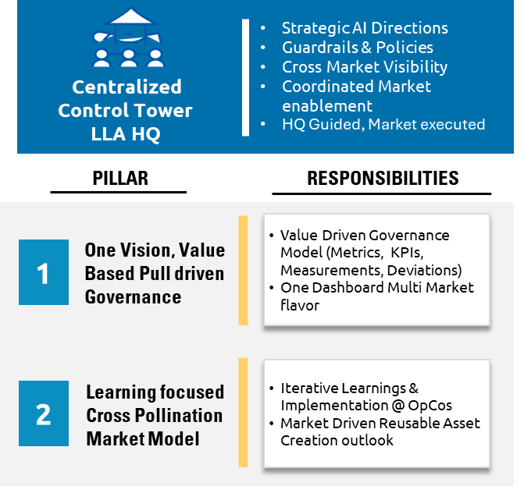
…for cross market coordination, transparency, consistent policy adherence, value tracking, and overall execution of use cases
AI CONTROL TOWER
North Star
LLA ↔ Market Journey View
Artefacts and ownership
Artefact | Responsible
Governance Charter | AI Governance Manager
Control Policy & Guidelines | AI Governance Manager
KPI Dashboard | Product Owner
Requirement Register | Deployment Analyst
Experiment Framework | AI Governance Manager
Go Live Approval checklist | Deployment Analyst
Value Realization register | Deployment Analyst & Governance Manager
Reusable Assets & Repository (Playbooks etc.) | Deployment Analyst & Governance Manager
Test Success/Failure & Lift Report | Deployment Analyst & AI Governance Manager
Cross Market Benchmark report | AI Governance Manager
“AI Control Tower acts as a light Touch, Strategic Direction, Risk Mitigating body”
Kick-off
AI Governance Manager will set up a control tower with input from market SPOCs and Sponsor.
AI Governance Manager, Deployment Analyst, Product Manager, and Market Compliance will align on AI use case design and guardrails at kickoff.
AI Governance Manager will define governance charter, policies, and value capture dashboard.
Senior Product Owner will specify models, KPIs, and success criteria in coordination with the control tower.
Senior and Product Owners will assess feasibility with market stakeholders through kickoff workshops and plan use case reuse.
AI Product Owner and Deployment Analyst will develop requirements, define the operating model, and start knowledge material creation.
Circular feedback
Deployment & Optimize
AI Product Owner & Deployment Analyst develops functional and business requirements with local input; validates within legal and regulatory limits.
AI Governance Manager enforces standardized experimentation methods and market compatibility, manages deployment approvals, risk acceptance, and monitors use case success.
Senior Product Owner oversees Value Realization Register and coordinates local market contacts and users.
AI Product Owner & Deployment Analyst ensures operational readiness, validates KPIs, and adheres to Control Tower policies.
Market Business Finance and Technical teams support adoption and sustainability through Knowledge Transfer, coordinated by AI Governance Manager, Product Owner, and Deployment Analyst.

Slide 19
Governance plan, risk registers, maturity and performance dashboards will be established right at kickoff with periodic feedback for a shared rhythm
ADDRESSING CHALLENGES
Challenges for LLA
Challenges for Markets
Mitigation steps
1
Socialization Challenges of Policy, Governance framework, Template, Performance monitoring across varied maturity level Markets
1
Different Flavors of markets would make it difficult for working within guidelines. Missing Local maturity & challenges
All policies/ guidelines/framework to include standard features with market specific guidelines laid by Governance Manager
Single SPOC Governance Mgr. for Markets
Tracker to segment markets on Maturity & Regulatory Complexity (High, Med & Low) ensured by Governance Manager & Deployment Analyst
All Use cases and agent designs templates & execution to have local extensions by Deployment Analyst
Risk based intake (High, Med, Low) instead of sequence driven deployment by Governance Manager
Single Experimentation framework with local extensions ensured by Product Analyst.
2
Difficulty of sharing expectations, benefits with markets. Lack of Vision & scope communication for markets
2
Lack of shared vision with risk of designing a LLA enforced 1 size fits all market philosophy model
Kick-off
3
Inconsistent Use Case designs forced by successful instances. Over engineering governance.
3
Changing deployment goals forced by successful instances. Circular and local challenges missing.
4
Prioritization of Use Cases for markets driven by LLA without markets view and feedback
4
Unclear expectation of LLA. Skill challenges coupled with regulatory and legal constraints
5
Non-Comparable Test Cases across markets. High deviations in benefits & deployment.
5
High pressure to deploy inspite of initial challenges, constraints, data deviations
Mandatory Success Gates for movement to next phase
Governance Mgr. works with market Deploy analyst to handhold, guide lightly
Go, No-Go decision only evidence based. Minimal qualitative decision making by Deployment Analyst & Governance Manager
1-1 Markets specific Circular feedback ensured by Governance Manager
Phased autonomy from supervised to semi autonomous way of working ensured by Governance Mgr
Centralized dashboard & Optimization playbooks made by Governance Mgr. and local markets in coordination
Risk register with early drift capture. Common working with markets Business Users by Deployment Analyst & Governance Mgr
6
Risk of deploying agents without adequate controls opening to future risks. Too many market exceptions.
6
Operational resistance to market AI driven use cases. Uneven deployment results leading to negative mindset challenges
Deployment & Optimize
7
Inconsistent Use Case designs forced by successful instances. Over engineering governance.
7
Changing deployment goals forced by successful instances. Circular and local challenges missing.
8
Prioritization of Use Cases for markets driven by LLA without markets view and feedback
8
Unclear expectation of LLA. Skill challenges coupled with regulatory and legal constraints

Slide 20




We integrate our experts with your AI governance ecosystem to address the gaps, enabling a robust federated governance factory
ROLE INTEGRATION
Liberty Latin America
AI Governance Team
Capgemini
AI Governance SME Team
AI Governance Control Tower
Governance & Decision
Use Case Orchestration
Value Realization
Knowledge Management
Integration & Enablement

Slide 21



AI Governance Manager and Sr. AI Product Owner set the protocols at LLA; AI Product owner and Analyst enables market execution
ROLE INTEGRATION
x
FTE Count
LLA
Head Quarter
C
Other Caribbean Markets
High-level business functions
AI Governance Control Tower
Description
LLA
Central
AI Governance Control Tower
Governance & Decision
x1
x1
AI Governance Manager
Sr. AI Product Owner
Solution Architect¹
Global Advisor¹
The team functions as the enterprise AI governance backbone, providing non-negotiable output to the markets
Governance standards
KPI taxonomy
Ethics and data policy
Stage-gate criteria
Vendor qualification
AI Use Case Orchestration
Value Realization
Governance charter
Ethics policy
Data standards
Vendor qualification criteria
Maturity assessment and decisioning
Use case prioritization and management
Technical architecture standards
  Integration patterns
  Data pipeline design
  Model serving infrastructure
  Security requirements
Strategic steer and program course-correction, if required
Knowledge Management
Integration & Enablement
Markets
x1
Assists markets locally execute use cases with Control Towers’s oversight
Use case prioritization within the approved framework
Experiment design for local context
Process redesign
Vendor relationships
Workforce change management
C
AI Product Owner
Market AI Strategy
Market AI Strategy
Market AI Strategy
Market AI Strategy
Run experiment; manage rollout
Primary day-to-day relationship with the market stakeholder
Operations
Operations
Operations
Operations
x3
Compliance & Legal
AI Development Analyst
F&PA
Implementation of use cases
Manage measurement infrastructure
Humar Resources Management
AI Vendor Management
¹Addtional roles recommended as part of the AI governance team to support business functions

Slide 22
Content
Capgemini Overview
Your Ask and Need for AI Governance
AI Governance Control Tower
AI Use Case Enablement
Implementation Blueprint
Knowledge Transfer
Commercials
Indicative Roles
Our Credentials
Assumptions

Slide 23
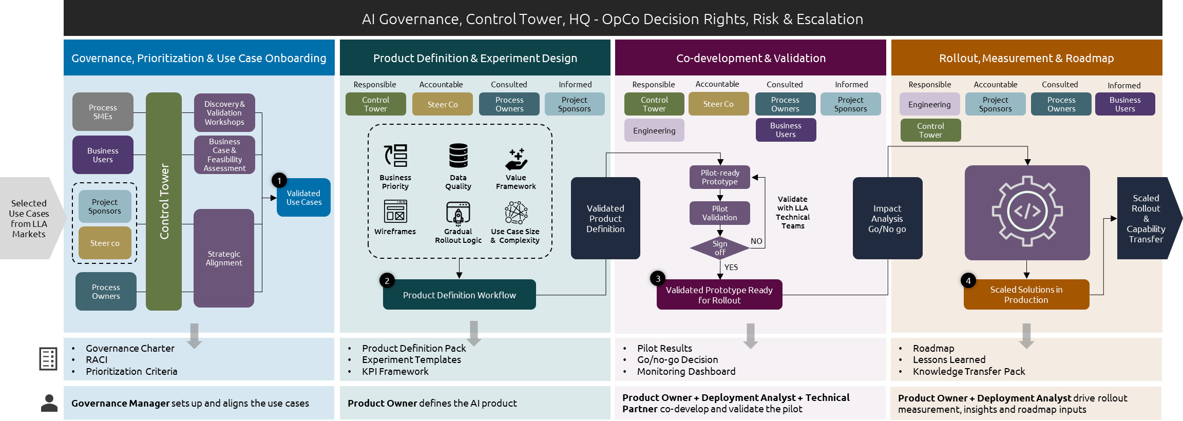
We will employ a structured AI product definition approach for prioritized use cases
USE CASE ENABLEMENT
High
Level
Process
Selected Use Cases
Local Market Needs
Available Data
Business Priorities
Model/agent type
Process Redesign
Experiments
Deployment Logic
Metrics Framework
Pilot-ready Product Specs
KPI Framework
Rollout Sequence
Roadmap Inputs
INPUTS
PRODUCT DEFINITION
OUTPUTS

Slide 24
Each use case will go through stage gates co-shaped with LLA to traverse the journey from concept to enterprise solution
USE CASE ENABLEMENT
1
Intake & Prioritization
2
Product Definition
3
Build & Experiment
Setup
4
Pilot and Measurement
5
Scale & Evolution
Confirm business problem, target outcome, and sponsoring stakeholder
Assess strategic fit, market relevance, and dependency on other use cases
Review data availability, process readiness, and feasibility constraints
Establish baseline KPIs and initial value hypothesis
Define model or agent logic, business workflow, and required process changes
Align success criteria, key metrics, and deployment logic with business and technical stakeholders
Document functional requirements, assumptions, and backlog priorities
Design experiment structure, including treatment/control logic and measurement approach
Support technical partner during solution development and validation
Finalize experiment setup, dashboards, controls, and test protocols
Prepare local operations for pilot launch, including stakeholders, processes, and training needs
Confirm readiness for controlled deployment
Execute gradual rollout across targeted markets or segments
Monitor experiment integrity, KPI movement, and operational adoption
Validate statistical significance, lift, and value capture
Surface issues, learnings, and improvement opportunities during deployment
Refine thresholds, business rules, process flows, and AI solution logic based on evidence
Capture lessons learned and build reusable assets for replication
Define scale-up priorities across markets and use cases
Transfer knowledge and feed insights into the AI evolution roadmap
Activities
AI Governance Manager
Senior AI Product Owner
AI Product Owner
Senior AI Product Owner
AI Governance Manager
Lead Role¹
AI Product Owner
Deployment Analyst
AI Product Owner
Senior AI Product Owner
Technical Partner²
Deployment Analyst
AI Product Owner
Gate 1: Use Case Approved
Clear business objective
Sponsor alignment
Initial feasibility
Priority confirmed
Gate 2: Product Definition Sign-off
Scope
KPIs
Experiment design
Operating model impact
Gate 3: Pilot Readiness Confirmed
Solution built
Experimental design operationalized
Controls in place
Launch prerequisites met
Gate 4: Scale Decision Made
Results meet success thresholds
Risks are understood
Rollout economics justified
Gate 5: Roadmap Institutionalized
Reusable assets captured
Roadmap agreed
Ownership transition to LLA teams and OpCos
Outcome
¹The leads roles are indicative. The roles will be updated based on the further details during the engagement. ²The Technical Partner will collaborate with the Products Owners and Deployment analyst for the technical landscape for use case deployment

Slide 25




For each use case, we’ll produce an experiment blueprint, validated impact evidence and a recommendation to refine, scale or stop.
USE CASE ENABLEMENT
Hypotheses
Experiment Design
Execution Validation
Impact Measurement
Scale Decision
Translate each prioritize use case into a clear business hypotheses
Establish expected impact on target KPIs, operating process and user behavior
Define success criteria and minimum thresholds for scale-up
Create treatment and control groups aligned to the use case and market context
Set experiment period, baseline metrics, sample logic and significance criteria
Confirm operational feasibility with business, market and technical stakeholders
Monitor correct assignment of treatment and control populations
Detect assignment bias, cross-group contamination and changes in sample composition
Ensure the AI intervention is deployed consistently with the defined product logic
Track KPI deltas between treatment and control groups
Validate statistical significance lift, and value capture against the baseline
Assess both business outcomes and operational side effects during rollout
Convert experiment results into actionable changes to thresholds, rules, segments, flows or process design
Decide whether to stop, refine, expand or industrialize the use case
Feed lessons learned into reusable assets and the long-term AI roadmap
Core Principles
Business-led Hypotheses
Every experiment starts with a defined business outcome and success threshold
Controlled Testing
Treatment/control design is used to isolate the effect of the AI intervention
Implementation Rigor
Experiment execution is monitored to prevent bias or inconsistent deployment
Evidence-based Scale
Only use cases with proven lift, and operational viability progress to larger rollout
Who Does What
AI Governance Manager
Senior AI Product Owner
AI Product Owner
Deployment Analyst
Ensures consistency of methods and scale-up standards across markets.
Defines hypothesis, KPI logic, and business success criteria.
Validates experiment setup, monitors contamination/bias, and quantifies lift

Slide 26












A structured validation process confirm value, feasibility, and go/no-go decisions before scaling use cases
USE CASE ENABLEMENT
Validation Design
Defining scope, success criteria and testing methodology
Pilot Validation
Running, monitoring and refining AI solutions in live environment
Go/No-go Assessment
Deciding whether to scale, revise or stop based on performance
ACCOUNTABLE
AI Governance Manager
RESPONSIBLE
Product Owner
ACCOUNTABLE
Product Owner
RESPONSIBLE
Technical Partner (LLA), Deployment Analyst
ACCOUNTABLE
AI Governance Manager, SteerCo
RESPONSIBLE
AI Governance Manager, Product Owner
DESIGN ACTIVITIES
EXECUTION FLOW
ASSESSMENT CRITERIA
Compare outcomes against targets
Assess technical stability
Establish KPI Baselines & Hypotheses
Select Pilot Cohorts
Design Experiment Control Logic
Perform Readiness Checks
Deploy pilot-ready solution
Track business model metrics
Capture User Feedback
Confirm financial impact (EBITDA)
Review remediation plans
Refine prompts & thresholds
Monitor exceptions/drift
1
Loop back to refinement
MILESTONE 1: VALIDATION PLAN APPROVED
Formal sign-off on roadmap & success metrics
3
2
MILESTONE 3: VALIDATED USE CASES READY FOR ROLLOUT
Final decision; moves to scaled production
?
Sign-off?
MILESTONE 2: PILOT RESULTS CAPTURED
Data collection complete; real-world performance scorecard
Refine & Retest
YES
NO
Validation Charter
KPI Baseline
Pilot Design Templates
Pilot Dashboard
Feedback Logs
Performance Scorecards
Go/no-go Recommendation
Validation Summary
Remediation Backlog
Validation success = Business Impact + Technical Stability + User Adoption + Operational Readiness

Slide 27
Indicative KPI Definitions, Data Sources, and Measurement Logic
KPI MEASUREMENT
KPI Area | Example KPI | Measurement | Indicative Source
Governance Adherence | Stage-gate completion | % of required lifecycle gates completed on time with documented evidence and approvals | Governance tracker, stage-gate review records, approval logs
 | Control Compliance | % of mandated policy, risk, legal, and control checks completed before pilot/rollout | Control checklists, compliance reviews, legal / risk sign-off records, deployment readiness logs
 | Documentation Completeness | % of required product definition, experiment, KPI, and deployment artifacts completed and approved | Product definition pack, experiment templates, KPI framework records, governance repository
Operational Adoption | User adoption | % of eligible users/agents actively using the AI capability in a defined period | App usage logs, user IDs, active session data
 | Recommendation acceptance | Accepted recommendations ÷ total recommendations shown | UI clickstream, action logs, decision audit trail
 | Override rate | % of AI recommendations manually changed or rejected by user | Workflow system logs and decision trace records
AI Risk & Quality | Accuracy | Correct predictions or correct outputs ÷ total evaluated cases, based on agreed business truth set | Model evaluation pipeline, QA sampling, labeled outcomes
 | Latency | Median / P95 response time from request to output | System telemetry, API logs, model monitoring tools
 | Hallucination / error rate | % of outputs that are factually wrong, non-compliant, or unusable based on QA rubric | Human QA review, policy checks, sampled transcript/output review
Experiment & Scale | Lift vs control | Relative improvement of treatment group over control for target KPI | Experiment tracker, KPI dashboard, statistical test outputs
 | Statistical significance | P-value / confidence threshold achieved for observed lift | Experiment analytics model and validation logic
 | Pilot-to-scale conversion | % of pilots meeting defined scale thresholds and approved for rollout | Governance decision log, stage-gate review records

Slide 28
Content
Capgemini Overview
Your Ask and Need for AI Governance
AI Governance Control Tower
AI Use Case Enablement
Implementation Blueprint
Knowledge Transfer
Commercials
Indicative Roles
Our Credentials
Assumptions

Slide 29
Implementation blueprint for governance, AI products, and deployment
IMPLEMENTATION
Phase 1: Groundwork
Phase 2: Functional Design
Phase 3: Launch & Measure
Phase 4: Evolution
Methodology
Discovery and baselining governance KPIs.
Value-first prioritization
Co-defining best practices for use cases/AI system lifecycle
Defining & establishing governance framework
Activating Governance Framework in production
Controlled Experimentation & Evidence accumulation
Systematic Scale & KT
Codify governance framework and execute structured handover.
Discovery to understand tech, regulatory, data landscape
Stakeholder mapping/Discovery workshops
As-is/maturity assessment
Technology/data landscape assessment
Defining Blueprints
Governance blueprint
Governance framework validation and sign-off
Governance Framework Operationalization framework
Pilot, validate and measure impact
Governance framework operationalized.
Pilot run with select UC
Scale and capture reusable assets
Governance operation handover to LLA
Workstream 1: Governance
Lead roles²:
AI Governance Manager
AI Governance Manager
Solution Architect¹
AI Governance Manager
Solution Architect¹
AI Governance Manager
(Sr.) Product Owner
Onboarding plan for 6 use cases
Pilot-ready product specifications
Design model / agent logic, process changes, and human-in-the-loop workflow
Define scale-up plans
Define experiment design, treatment-control logic, deployment logic and success criteria
Assist with build, integration, and readiness checks alongside technical partners
Track lift and value capture
Conduct pilot or controlled launch in select markets
Oversee experiment integrity, adoption, and operational results
Consolidate reusable assets, playbooks
Roll out roadmap as per use-case and market
Workstream 2: Production
Lead roles²:
Sr. Product Owner
Sr. Product Owner
Solution Architect¹
Sr. Product Owner
Solution Architect¹
Sr. Product Owner
Functional Design Complete
Launch & Measure Complete
Evolution Complete
Groundwork Complete
Governance Framework established
Experiment blueprints and pilot success criteria signed off
Use cases defined as business products
Governance Operationalization framework published
Controlled pilots executed
Validation results captured and scale / hold / iterate decisions made
Repeatable measurement rhythm established
Markets Performance Measurement
Reusable assets captured
Market scale-up priorities defined
Roadmap and knowledge transfer institutionalized
Cross Market Knowledge Transfer Completion (Process, KPI Dashboard, Risk Report, Optimization plan handover)
Program cadence, Revised project plan
AI initiative inventory
Prioritized use cases onboarded
Initial product definition and KPI baseline approach agreed
E2E AI product definition blueprint
Outcome
¹Addtional roles recommended as part of the AI governance team to support business functions. ²The leads roles are indicative. The roles will be updated based on the further details during the engagement

Slide 30
Governance & Strategy: Mandate setting, Policy, Framework ownership
RACI
R
Responsible
A
Accountable
C
Consulted
I
Informed
Recommended additional roles
Activity | AI Governance Manager | Senior AI Product Owner | AI Product Owner | AI Development Analyst | Solution Architect | Global Advisor
Define AI governance mandate and scope | R | C | — | — | — | C
Design and publish AI governance framework | A/R | C | — | — | — | C
Establish AI ethics and acceptable-use policy | A/R | C | — | — | — | C
Define data governance standards and cross-market rules | R | — | — | — | C | C
Design AI workforce augmentation policy | R | — | — | — | — | C
Establish vendor governance and make/buy/partner criteria | R | C | — | — | A | C
Define AI CoE operating model and role charters | R | C | C | — | — | C
Quarterly governance maturity assessment | R | I | I | — | I | C
Board-level AI performance and governance reporting | R | C | — | C | — | A
Regulatory and compliance risk monitoring | R | — | — | — | — | C
Market tiering assessment (Tier 1/2/3 classification) | A/R | C | I | — | — | C
Annual AI portfolio strategy and Wave planning | C | A | C | — | C | R
Approved vendor list maintenance | C | C | — | — | R | —

Slide 31
Use case lifecycle: Prioritization, Experiment design, Build, and Scale
RACI
R
Responsible
A
Accountable
C
Consulted
I
Informed
Recommended additional roles
Activity | AI Governance Manager | Senior AI Product Owner | AI Product Owner | AI Development Analyst | Solution Architect | Global Advisor
Develop and maintain use case prioritization framework | R | A | C | — | — | C
Score and rank use case backlog (quarterly refresh) | C | A | R | C | C | I
Define experiment hypothesis and success metrics | C | A | R | C | C | —
Design experiment plan and scope | — | A | R | C | C | —
Run and monitor experiment day-to-day | — | A | R | R | C | —
Mid-point review and continue/pivot/halt | C | A | R | R | C | —
Result card and build/scale/kill decision | A | R | C | R | C | C
Process redesign and human-AI handoff model design | C | A | R | — | C | —
Approval: Experiment → Controlled Rollout → Market Activation → Portfolio Scale | C | A | C | C | C | A
Change management planning per use case rollout | R | C | C | — | — | —
Local use case prioritization (within approved backlog) | I | C | C | — | — | —
2.16 Local experiment scope adaptation (language, data sources) | — | C | C | — | C | —

Slide 32
Process & Technical Delivery: Architecture, Deployment, Data, and Integration
RACI
R
Responsible
A
Accountable
C
Consulted
I
Informed
Recommended additional roles
Activity | AI Governance Manager | Senior AI Product Owner | AI Product Owner | AI Development Analyst | Solution Architect | Global Advisor
Design enterprise AI and data architecture standards | — | C | — | — | R | —
Define integration patterns (CRM, contact centre, BSS/OSS) | — | C | C | — | R | —
Vendor technical evaluation and qualification | — | A | C | — | R | C
AI model selection and build/buy/adapt decision | — | A | C | — | R | C
Data pipeline design and quality assessment | — | C | C | R | C | —
Model performance monitoring setup | — | C | C | R | C | —
Security and data privacy review per use case | C | — | — | — | R | —
Technical deployment and go-live per market | — | A | R | C | R | —
User acceptance testing and agent training | — | C | A | R | C | —
Hypercare and post-launch stabilization | — | A | R | R | C | —
Technical platform and tooling standards documentation | — | C | — | — | R | —
Vendor SLA and performance management | — | A | C | R | C | —
Local technical environment assessment (per market) | — | C | C | — | R | —

Slide 33
Performance & Reporting: Measurement, Benefit tracking, and Steering
RACI
R
Responsible
A
Accountable
C
Consulted
I
Informed
Recommended additional roles
Activity | AI Governance Manager | Senior AI Product Owner | AI Product Owner | AI Development Analyst | Solution Architect | Global Advisor
Define AI KPI taxonomy and measurement framework | R | A | C | C | — | C
Baseline all live use cases against KPI taxonomy | C | A | C | R | — | —
Build and maintain AI performance dashboard (enterprise) | C | C | C | R | — | —
Build and maintain AI performance dashboard (per market) | — | C | C | R | — | —
Weekly use case progress reporting | — | C | C | R | — | —
Monthly AI performance review pack preparation | C | C | C | R | — | —
Monthly performance review facilitation | A | R | C | C | — | C
EBITDA attribution and benefit tracking | — | C | C | R | — | C
Capability transfer scorecard (quarterly) | A | C | C | C | C | C
AI vendor performance scorecard | — | A | C | R | C | —
Market-level KPI reporting and validation (local) | — | I | C | R | — | —
Cross-market AI learning synthesis and distribution | C | C | — | R | — | —
AI program risk and issue log | C | C | C | C | C | —

Slide 34
Content
Capgemini Overview
Your Ask and Need for AI Governance
AI Governance Control Tower
AI Use Case Enablement
Implementation Blueprint
Knowledge Transfer
Commercials
Indicative Roles
Our Credentials
Assumptions

Slide 35
Capgemini will align the KT success criteria and associated KPIs in line with LLA requirements and success metric to ensure a smooth transition
KNOWLEDGE TRANSFER
Legend:
LLA led; AI Governance Manager
Shared; Market SPOCs, Deployment Analyst, Product Owner
Knowledge transfer initiation
Artefacts
Handover and closure
1
Governance & Program Readiness (LLA‑led)
AI Governance Manager appointed at LLA and Market AI SPOCs
Governance Charter
1
Operational Handover
Process Change signoff by Market SPOCs, Business Users, Governance Manager
AI Governance Charter, Control Tower model socialized across LLA & markets
Human in loop control established by Deployment Analyst & Market SPOC
Risk‑based KT scope agreed per use case (High/Med/Low)
Risk Register
KPI Measurements & final Data signed off by Governance Manager, Market SPOCs
2
Use Case & Market Readiness
Knowledge Acquisition & KT Plan approved per use case & per market
KT Plan
2
Lifecycle Closure & Handover
Build, Test &Deploy KT completed and validated by Market SPOCs & Users
Phase wise milestones defined and agreed
Implementation Plan
Optimize & Control playbooks, Runbooks handed over by Governance Manager & Deployment
Local regulatory & operational readiness validated with Market SPOCs
Regulatory Policy Guardrails
Change Understanding document signed off by Market SPOCs, Business Users
3
Market executed, LLA validated
Access to AI repositories, dashboards, environments enabled
KPI Dashboard
3
KT closure & Sustenance
KT completion & market readiness report signed off by LLA
User roles aligned to governance and human‑in‑loop requirements
Use case transitioned to BAU with Control Tower oversight
KT cadence like playbooks, workshops, shadowing finalized
Templates for Runbooks/Playbooks
Optimization Roadmap agreed with Market SPOCs, Governance Manager & Sponsor
LLA defined; Market Validated Success Metric
Knowledge KPI
People KPI
Service KPI
KT Completion Rate
KT Success Rate
Coverage
Quality
Certified artefacts completed / planned artefacts
KT burn up vs lifecycle milestones
No. of trained resources
Shadow to Own transition confirmed
Accepted deliverables
No. of escalations during deploy and early optimize phase

Slide 36
Content
Capgemini Overview
Your Ask and Need for AI Governance
AI Governance Control Tower
AI Use Case Enablement
Implementation Blueprint
Knowledge Transfer
Commercials
Indicative Roles
Our Credentials
Assumptions

Slide 37
Engagement model recap: outcome-led now; service-based later
ENGAGEMENT MODEL
RFP Scope Duration
Post RFP Managed Services
Stage 1 (6 months): Capacity‑Led Setup with Defined Outcomes
A hands‑on phase to build, test, and operationalize the model
Stage 2 (7th month onwards: Evolution to Managed Services)
Once governance is proven and consistently adopted
Setup AI Governance
Setup Use Case factory
Knowledge Transfer to LLA
Managed Services
Design and operationalize central AI governance
Cover risk & compliance, data & AI standards, and Governance
Establish control‑tower mechanisms (portfolio visibility, lifecycle, risk, approvals)
Validate and refine governance through real application
Focus on LLA‑prioritized functional areas
Define common framework for use case definition, experimentation, measurement, and scale
Work hands‑on with a limited set of prioritized use cases to prove and refine the model
Flexible ramp‑up or reprofiling as readiness evolves
Transfer knowledge, tools, and processes so LLA teams can independently run and scale AI initiatives
Conduct walkthroughs, shadowing, and documentation during real use cases to ensure practical understanding
Ensure smooth handover of governance, use case execution, and decision-making to LLA teams
Ongoing AI governance operations and reporting
Portfolio governance & compliance assurance across OpCos
Scaled enablement of AI use cases with KPIs and service‑based accountability
Note: As a long‑standing partner, we will proactively submit a managed services proposal outlining how the show will be operated going forward.

Slide 38
Content
Capgemini Overview
Your Ask and Need for AI Governance
AI Governance Control Tower
AI Use Case Enablement
Implementation Blueprint
Knowledge Transfer
Commercials
Indicative Roles
Our Credentials
Assumptions

Slide 39




We have delivered strategic advisory on AI Adoption and Governance to clients across the globe
CREDENTIALS
LARGE TELCO IN NORDICS
AI factory setup
LARGE EUROPEAN TELCO
Setting up an AI Office
LARGE EUROPEAN TELCO
AI Adoption and enablement program for employees
LARGE EUROPEAN TELCO
AI Adoption program
LARGE TELCO IN THE US
Contact Centre transformation
GLOBAL LOGISTICS COMPANY
AI factory setup
GLOBAL BANK
AI governance

Slide 40


GPU-As-A-Service: AI Factory
Large Telco in Nordics
CREDENTIALS
AI Factory – Delivered Enabling secure, sustainable, and scalable AI innovation for enterprises A leading Nordic telecom operator partnered with Capgemini and NVIDIA to launch Norway’s first sovereign AI Factory. This initiative empowers enterprises to accelerate AI adoption while ensuring compliance, sustainability, and cost efficiency.
The AI Factory enables customers to innovate and accelerate AI ambitions in a secure and sustainable way
Opportunity & threats:
Identify and prioritize AI opportunities across industries while mitigating risks related to compliance and sustainability.
Company know-how & operating model:
Establish an efficient governance and operating model for AI Factory adoption, ensuring scalability and cost efficiency.
Technology & Toolbox:
Deploy best-in-class GPU-as-a-Service and sovereign cloud infrastructure, leveraging NVIDIA architecture for high-performance AI workloads.
Strategy and Awareness:
Drive awareness on sustainable AI practices, align stakeholders, and create a roadmap for future expansion and innovation.
Simplified experimentation and accelerates production deployment
Reduced integration time and complexity
BENEFITS
Aligned with sustainability and compliance priorities

Slide 41

Established a Generative AI Office for Tier 1 Telecom to ensure precise prioritization and capabilities from idea collection to industrialization​
Large European Telco
CREDENTIALS
A Tier 1 Telco in Europe was facing issues in tracking and organizing different GenAI PoCs and initiatives across their organization. There's a lack of a defined structure and strategy for prioritizing use cases and ensuring they choose the right technology. Capgemini is engaged to setup a GenAI office to ensure precise prioritization and capabilities for scaling use cases.
The project comprehends four different streams, each focusing on important topics to ensure that the client is ready to scale their chose Generative AI use cases
Opportunity & threats: Mapping opportunities, prioritizing use cases, and qualifying relevant opportunities.
Company know-how & operating model: Proposing an efficient operating model and GenAI target skillset by population
Technology & Toolbox: Understanding the current state, defining a target stack and architectures, selecting implementation solutions, and identifying quick wins.
Strategy and Awareness: Raising awareness, aligning stakeholders, and presenting a shared vision.
Capgemini created the structure and long-term plan (until FY28) for all the GenAI initiatives for VF Network and delivered strategic GenAI development too.
Improved time to experiment and put into production
Reduced costs at production time
BENEFITS
Create org-wide awareness and skillset

Slide 42

Design and Deployment of a company-wide AI adoption and enablement program for a Leading European Telecom Operator
Large European Telco
CREDENTIALS
Capgemini supported the client in the design and deployment of a company-wide AI adoption and enablement program, focused on building awareness, capability and impact around Microsoft Copilot and Generative AI tools. The initiative covered all organizational layers (strategic, tactical, and operational) and aimed to boost both cultural adoption and productivity through targeted training, content creation, and AI use case workshops.
Under the broader challenge of GenAI adoption, the project is exploring and is working on:
Real-life productivity use cases with Copilot tools (Word, Outlook, Excel, Teams, Loop).
Strategic AI use cases that impact business units' operations, explored through tailored workshops and roadmaps with internal “AI Champions”.
Use case discovery sessions with key departments to tailor future deployments.
The project is structured around 3 levels of engagement:
Strategic: high-level awareness and vision-setting with directors and leadership teams, using inspirational use cases and storytelling.
Tactical: specialized tracks for AI Champions and middle managers to empower decentralized enablement and identify business-relevant use cases.
Operational: scalable training and onboarding paths for all employees with hands-on sessions, content, and FAQs for GenAI tools.
Sessions are being delivered via hybrid models (virtual and on-site), supported by workshops, co-created content, digital guides, video explainers, and practical toolkits.
1,200+ users to be trained across all organizational levels
80+ training and enablement sessions planned
BENEFITS
200+ AI use cases documented and scored to inspire local application

Slide 43

Driving AI Adoption
Large European Telco
CREDENTIALS
Context
Leading French Telecom partnered with us to accelerate the adoption of its internal AI assistant platform and unlock greater business value.
The engagement aimed to build on initial efforts by driving broader usage, enhancing user experience, and ensuring alignment between AI capabilities and organizational priorities.
25+
assistant
delivered
Challenge
Existing usage focused on simple text manipulation, not on real business-critical tasks
Low awareness and fragmented usage of AI tools across teams
Lack of clear best practices and literacy on AI capabilities
Limited engagement from AI champions community
Disconnect between Data & AI roadmap and business priorities
15+
Champions onboarded
BENEFITS
Approach
Conducted a comprehensive mapping of current tool usage, pain points, and unmet needs
Designed and deployed custom GPT-based assistants tailored to team workflows
Led AI literacy initiatives: best practices, news updates, and reactivation of AI champions community
Collaborated with Data & AI team to align roadmap with evolving business requirements
Updated company-wide best practices to integrate AI assistants into workflows
80%
Token usage
increase

Slide 44

Contact Center Transformation
Large Telco in the US
CREDENTIALS
Context
The client’s customer engagement technology ecosystem had evolved organically over time, resulting in a mix of legacy platforms and siloed point solutions added to meet short‑term business needs.
As the business scaled and customer service expectations increased, the existing technology stack struggled to support consistent, efficient, and insight‑driven customer interactions.
4
Proof of Concepts developed
Challenge
A fragmented and complex CES landscape that was difficult to scale, expensive to maintain, and prone to operational inefficiencies.
Heavy reliance on manual workarounds, leading to inconsistent customer experiences across channels and limited visibility into service performance metrics.
End‑of‑life risks for some vendor-supported components, increasing operational and compliance exposure.
225
Backlog features identified
BENEFITS
Approach
Conducted a current-state assessment covering IT landscape, contact center operations, and data flows to identify optimization opportunities.
Defined a business case and KPI framework to quantify cost savings, efficiency improvements, and commercial impact, guiding investment decisions.
Established a target operating model and governance framework to support a scalable Customer Engagement Solution (CES).
Executed controlled technology PoCs (Conversational IVR, Agent Assist, Google‑powered Search, Customer Interaction Data & Insights) to validate Google’s capabilities prior to broader rollout.
$419M
Projected 5-year savings

Slide 45

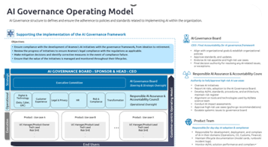
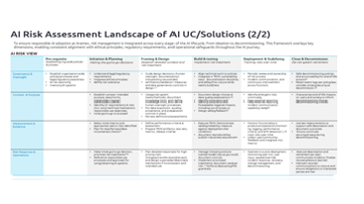
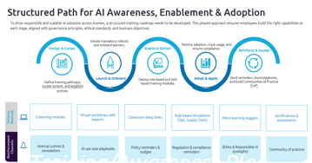
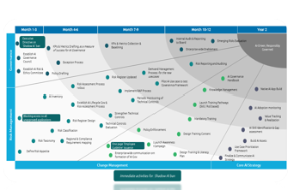
We architected the AI Governance Framework to balance Innovation, Risk, and Compliance for a leading, global logistics giant
Global Logistics Company
CREDENTIALS
Context
A multinational logistics, courier, and package delivery company operating across ~70 countries set out to embed Trustworthy AI as a foundational principle within its 5‑year Digital & Technology Strategy.
The ambition was to modernize enterprise capabilities and deliver superior customer experience through responsible and scalable AI/GenAI adoption.
Enterprise-wide visibility and control over AI initiatives
Challenge
AI and GenAI initiatives were fragmented across teams with no centralized inventory or transparency of AI systems in use at an enterprise level.
Absence of a standardized AI risk and governance model increased regulatory, security, and reputational exposure across markets.
Approach
Conducted structured stakeholder workshops with Legal, CISO, GRC, Marketing & Customer Experience, and Data & Infrastructure leaders to build a shared understanding of regulatory expectations, risk priorities, and business needs.
Designed a group-wide AI governance framework applicable across all AI and GenAI initiatives, anchoring responsible AI principles into operational execution.
Defined an end-to-end AI risk management framework, aligned with global regulatory requirements, along with a clear governance structure and operating model.
Outlined the required policy architecture and developed a training and awareness plan to embed AI governance capabilities across the organization.
Improved regulatory preparedness and risk mitigation
BENEFITS
Key Deliverables
Organization-wide adoption of responsible AI practices
Operating model /
governance
Risk Management Framework
Training/Awareness Plan
Operationalization

Slide 46
Content
Capgemini Overview
Your Ask and Need for AI Governance
AI Governance Control Tower
AI Use Case Enablement
Implementation Blueprint
Knowledge Transfer
Commercials
Indicative Roles
Our Credentials
Assumptions

Slide 47
Assumptions and Dependencies
Assumptions
LLA will nominate single point of contact for the project from LLA side, and formally communicate it to Capgemini at the start of the project
Joint workshops will be conducted by Capgemini for scoping, validation and sign off of the deliverables as per agreed execution plan
LLA will ensure availability of internal stakeholders for workshops, ad-hoc meetings, discussions , communication etc. during the project.
Deliverables will be deemed accepted if no feedback received within 3 working days post submission
Dependencies
Data/information availability to complete the assessment
Stakeholders' availability for workshops/Meetings/Reviews.

Slide 48
Make
it
real.

